Slide 1


Effectively integrating AI into Academia
A journey of Ambidexterity
S.Takavarasha , L. Mapepa

Slide 2
Role of AI in Scientific networking and collaborations
Automating tedious tasks
Important Considerations When Using AI in Academia
Jjjjionnnnnnnnnnnnnnnnjlkkkkk knkkkkkkkkkkkkkkkkkkk
AI powered automation of Teaching and learning
AI content detection tools
1.
2.
3.
4.
5.

Slide 3

AI changing definition
Intelligence sometimes seen as the ability to adapt, solve problems, plan, improvise in new situations, and learn new things.
Today's AI systems might demonstrate some traits of human intelligence, including learning, problem-solving, perception, and even a limited spectrum of creativity and social intelligence
Optimists: Yann LeCun, Chief AI Scientist at Meta: "AI is still in its early stages, but it has the potential to make our lives better in many ways." (2022)
Admonitorists: Elon Musk, CEO of Tesla and SpaceX: "The development of superintelligence is potentially the greatest existential risk humanity faces." (2014)
Collaborativists: Yoshua Bengio, Turing Award Winner and AI Professor: "We need to develop AI in a way that is aligned with human values." (2023)

Slide 4

A journey of endless exploring and testing
AI can increase student learning outcomes and reduce lecturer workload
Its a constantly evolving phenomenon characterised by the advent of new tools
Effective use of AI calls for an Ambidexterous approach:
  Exploit the technologies that you know
  Keep hunting for newer and better application
Assess the reviews by other users and experts
Learn from your own use of different applications
Above all observe academic ethics

Slide 5
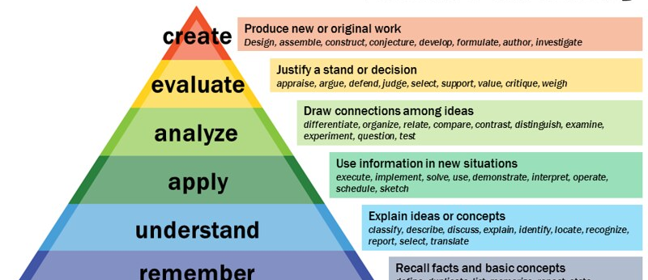
What is the best use of our time as researchers?
Memorizing versus conceptualization, abstraction philosophical exegesis
Doing long division?
Calculating sample size manually?
Memorizing the periodic table?
Life without AI highly punishing and less rewarding
Typing without a spell check
Transcribing hours of interviews
Automation of lower level tasks grants us time to do more at the higher levels
Doing a t-test was worthy a PhD years ago now using t-test creatively may earn a PhD

Slide 6

Scientific networking, aggregating and collaborations
‘Academics are polished by interacting with other academics.’ Rasian Maaraj
Scientific Matchmaking with AI: AI can facilitate connections between researchers with similar interests by analyzing research topics and publications.
This can foster collaboration and accelerate scientific progress by bringing together experts from different fields.
Voce Viewer: www.voseviewer.com a software tool for creating maps based on network data and for visualizing and exploration purposes of maps
Connected papers: www.connectedpapers.com Ideal for authors that want to write a scoping paper or Conducting a Bibliometric mapping

Slide 7

Automating tedious tasks
Literature reviewing: Whether your are conducting a systematic review or narrative review AI tools will help
Reading toolsText to voice tools: the best innovation since sliced bread
Academics are incessant readers and reading is a pain that never stops hurting
AI text to voice tools allow us to listen to what we should be reading therefore consume more literature than we would manually
‘One machine can do the work of 50 ordinary men. No machine can do the work of one ordinary man.’ Albert Hubbard

Slide 8
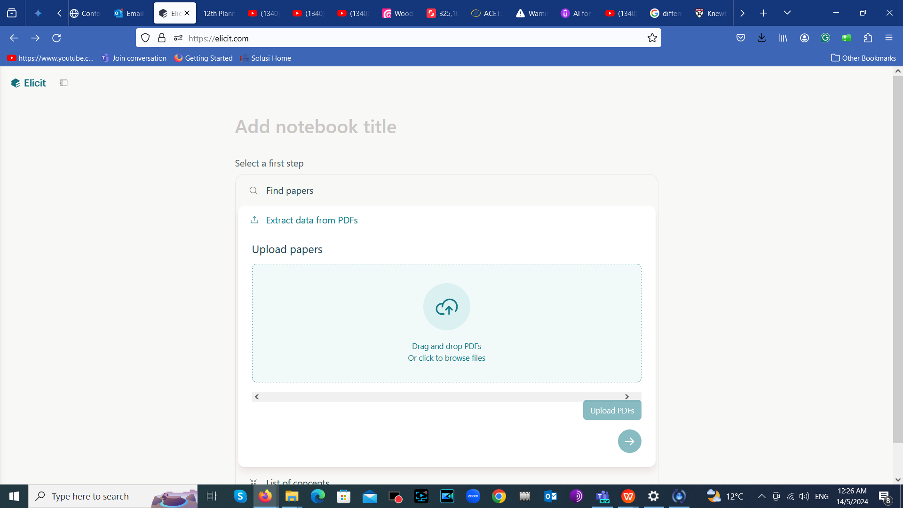
https://elicit.com/
Elicit uses language models to help you automate research workflows, like parts of literature review. Elicit can find relevant papers without perfect keyword match, summarize takeaways from the paper specific to your question, and extract key information from the papers.

Slide 9
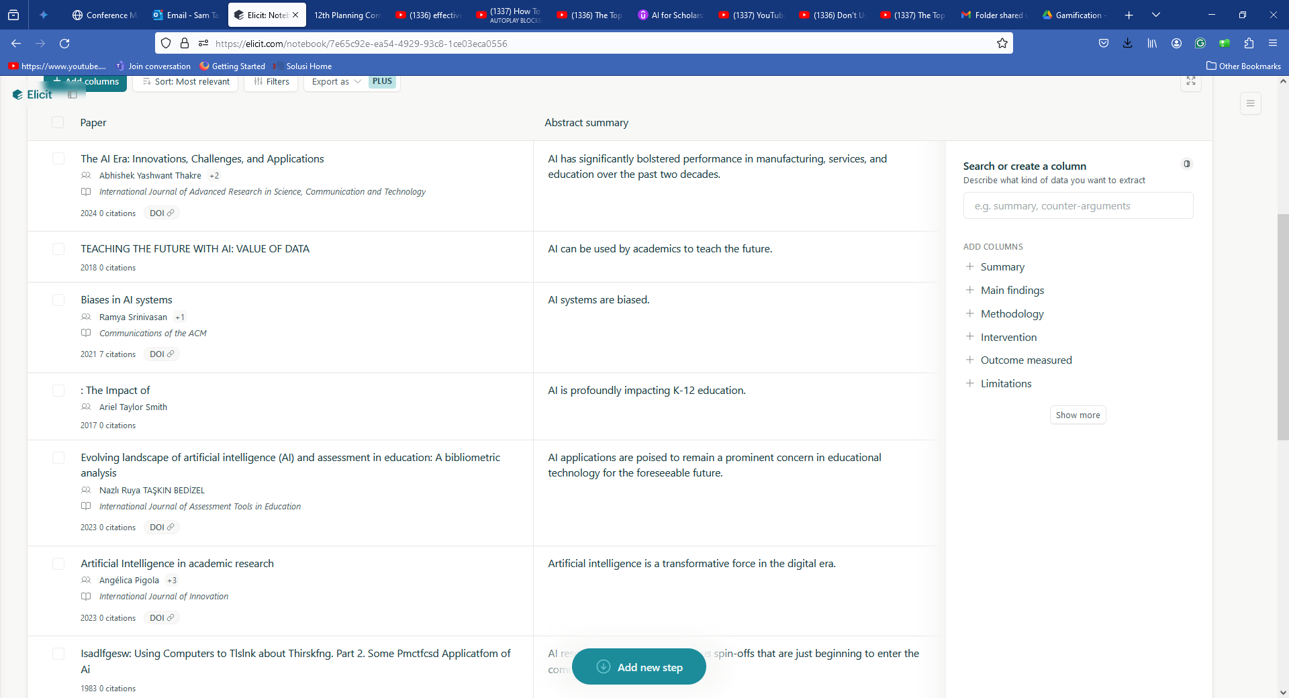

Slide 10
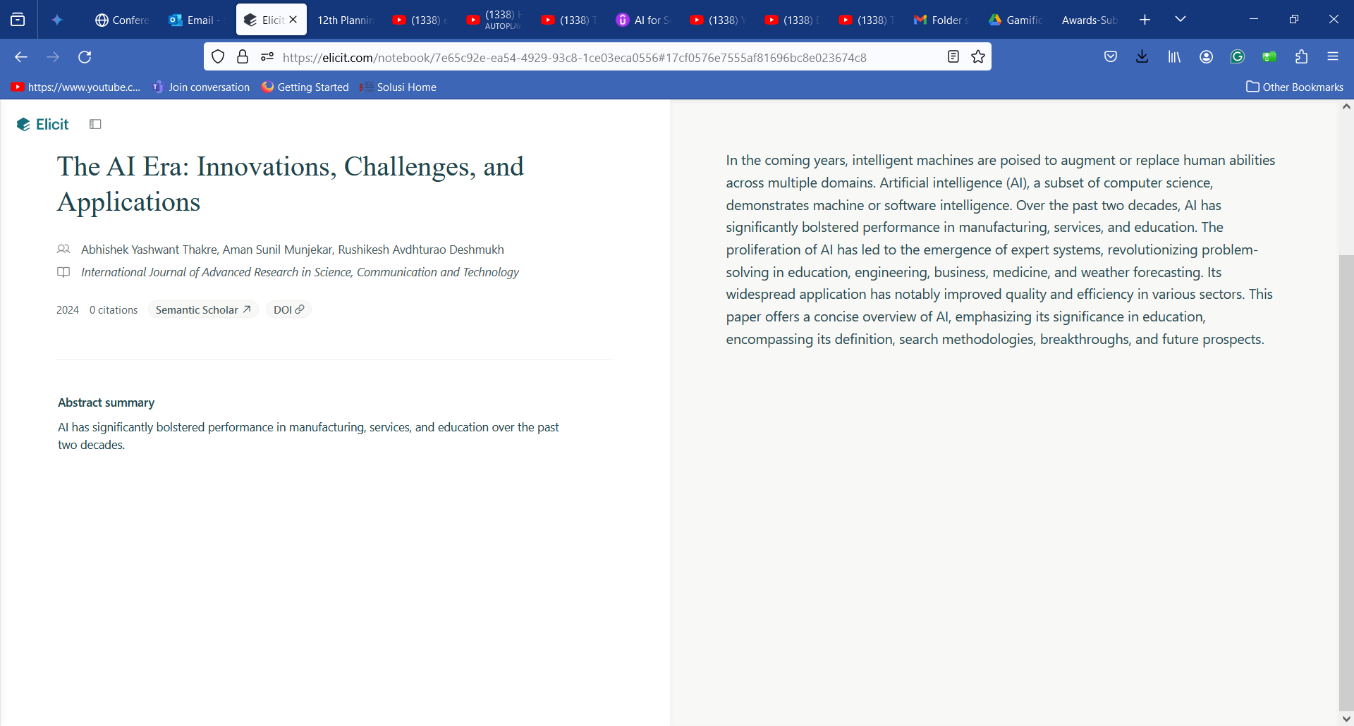

Slide 11

AI powered automation of Teaching and learning
Personalized Learning Pathways: AI can personalize the learning experience by tailoring educational materials and assessments to individual student needs and learning styles.
AI can lead to improved learning outcomes and increased student engagement in online or classroom settings.
Adaptive learning: Adapt to individual pace of learning and increase to the depth and complexity in order to challenge the learner

Slide 12
AI automation of Teaching and learning
AI can help Adminstrative task, lesson plans, assessing student needs & designing class essessment tools
Course creation and lesson planning: Use Copilot https://www.copilot.com/ , Class point https://www.classpoint.app/ or ChatGPT
Saves time in designing content and creating visuals
Differentiated learning: Use Dreambox, Smart sparrow and Newton(customise learning based on students preferences personal traits
Proctoring: Validating the authenticity of the candidate
AI enrollment systems for match students to programs: Analysing skill sets and matching them to existing programs

Slide 13
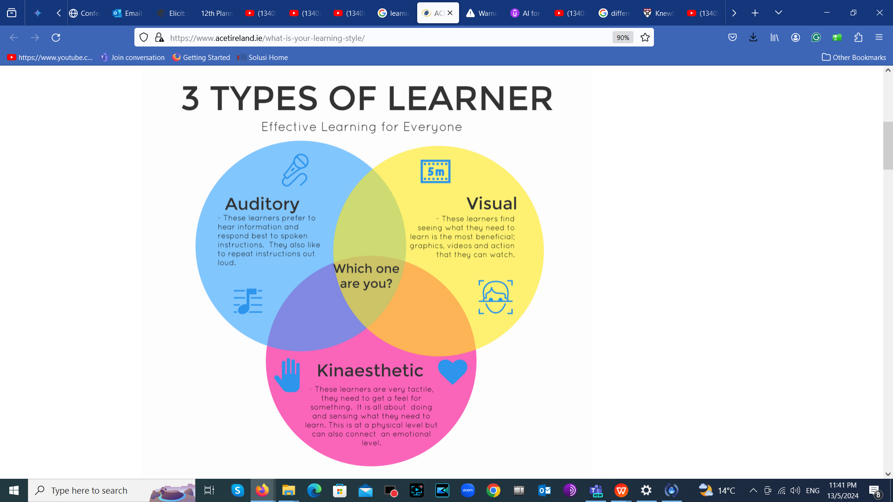
Different learning styles
There are 4 predominant learning styles:
Visual, Auditory, Read/Write, and Kinaesthetic.
‘’The most important paths to acknowledge
edge are the different modes of absorbing information, the different
ways of organizing information, and the different strengths in the
learning cycle.”(Jacobson, 2001) Seatle review)

Slide 14
AI and Personalised learning
Scholars of pedagogy and andragogy have spoked about the necessity of personalised learning(Bernacki et al, 2021; Sheshak & Spector, 2000).
This has n’t been easy to implement at classroom level due to time constraints and lack of resouces ( e.g. University world article: anonymous lecturer complains about pressure due to different expectations of different students and parents)
AI has introduced tools that allow Differentiated learning ( for self directed learning and mastery based progression) e.g. Dreambox: for maths and reading
Smart sparrow: https://www.smartsparrow.com/ for general differentiated learning
Knewton: for other stem subjects. Analyse students data for personalised lessons

Slide 15
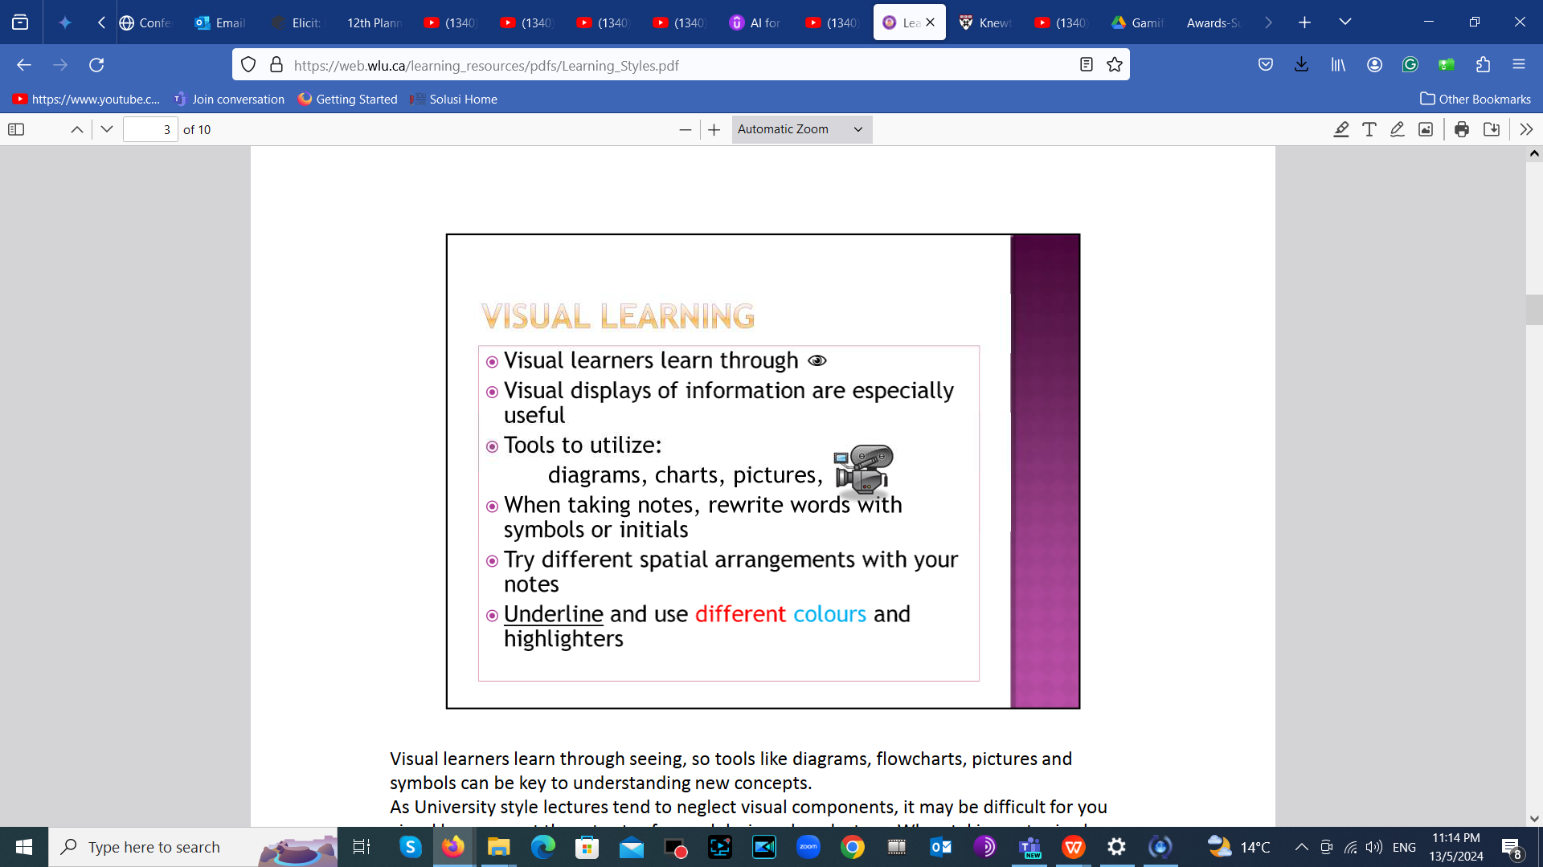
Visual designs: Some of us are visual

Slide 16
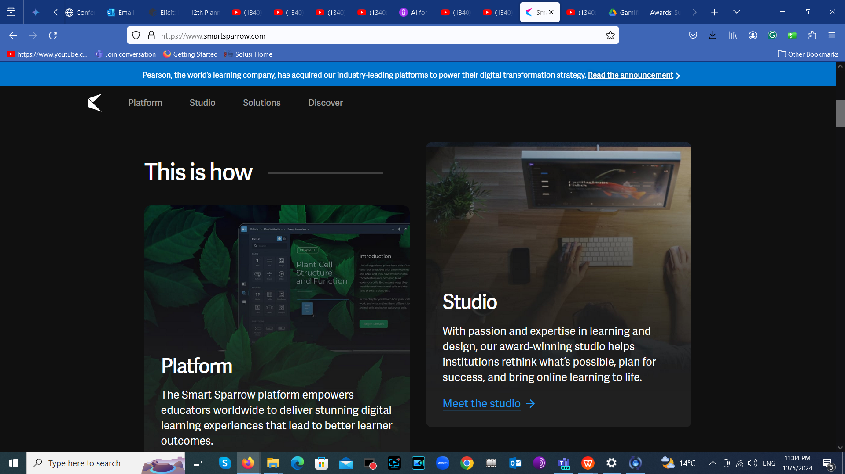
Visual designs: Some of us are visual

Slide 17
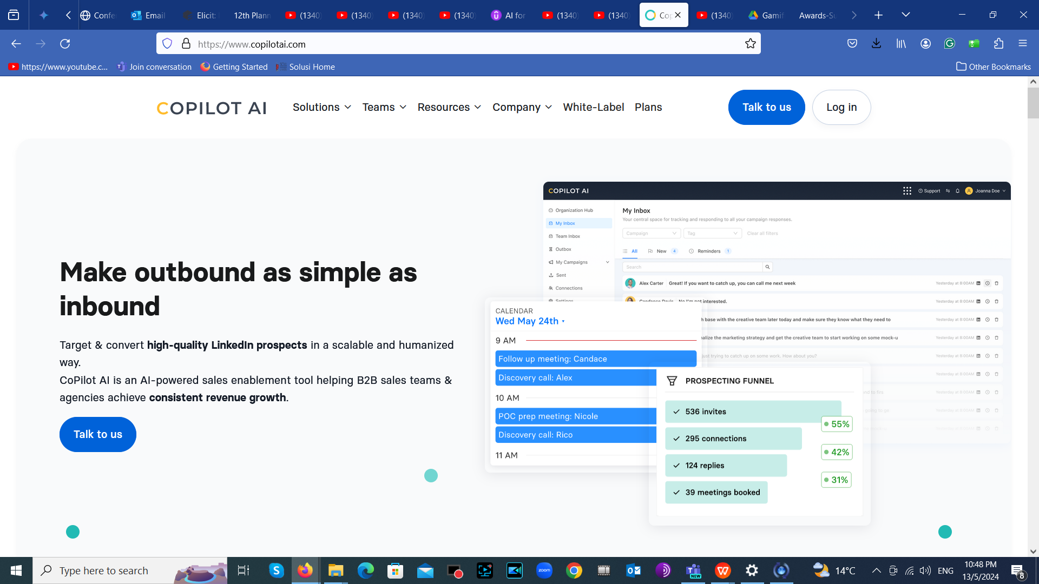
https://www.copilotai.com/

Slide 18
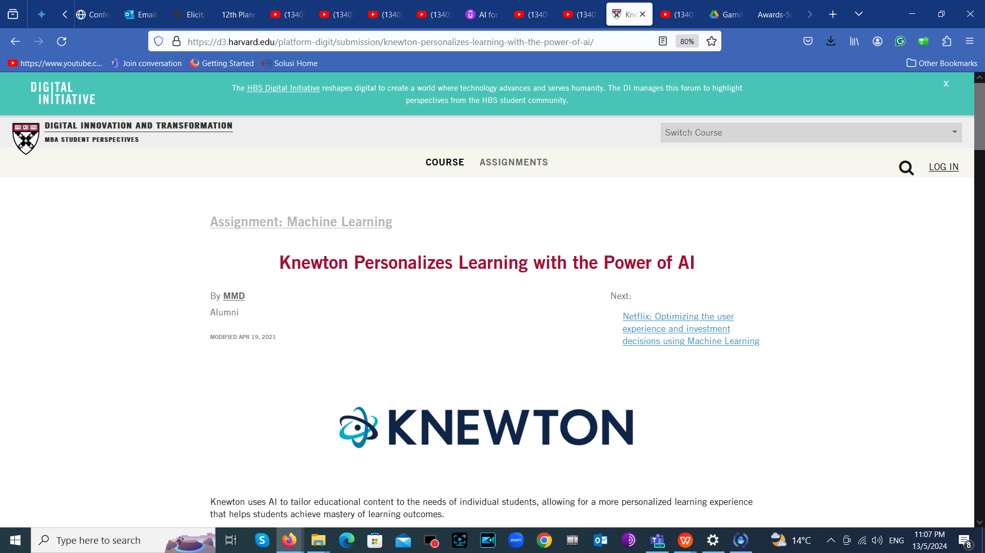
https://d3.harvard.edu/platform-digit/submission/knewton-personalizes-learning-with-the-power-of-ai/

Slide 19
Course creation and lesson planning | CopilotAI:uses AI for structured lesson plans,Class point: AI powered quiz questions, from data on your slides. Use it for evaluating your students understanding during lessons against preset objectivesChatGPT: lesson plans, rubric or added information
Differentiated learning( for self directed learning and mastery based progression) | Smart sparrow:for general differentiated learningKnewton: for other stem subjects. Analyse students data for personalised lessons
Auto grading (highly controversial so far) | Grade scope: Set criteria per question, let it go through and grade your students for you
Pin point knowledge gaps | Edmontum or extact path(uses students performance to create personalised learning paths to help students improve. Use of tracking students progress
Test preparations | Exam soft or Class point: creating quizzes and tests.Exam soft: can analyse your data and determine the questions to ask. Or class point: can generate quizzes from you lesson content
Task automation | Use Zapier, streamlining administrative work and reduces time for sorting data sending email reminders etc leaving you time to focus on your lessons and interacting with your students
Student feed back | TurnItin’ s AI feedback studio. Students feed back in a key part of teaching and learning and it must not be done in a subjective way, use AI to do it objectively. It also includes text editing issues I.e. punctuation and grammer
Adaptable universal access | Use AI live captioning like AI Media or Power point. Bridging the gap between students backgrounds by converting speech to text helping student to understand lecturers inspite of different accents
Visual smart teaching assistant | ChatGPT as you use google to get personalised answers to questions. ChatGPT to conduct Admin tasks, lesson planning, conduct research

Slide 20
Automating research and Innovation
Scientific Writing Assistant: AI tools can assist with scientific writing by checking grammar and plagiarism, suggesting citations, or even generating drafts based on existing research. Additionally, machine translation powered by AI can help overcome language barriers in research communication.

Slide 21
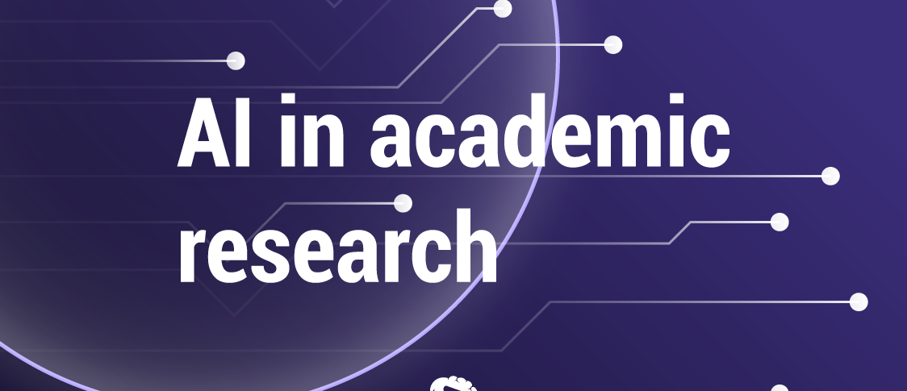
The Future is AI
Andrew Ng, Chief AI Scientist at Landing AI: "AI is the new electricity. It's going to be woven into the fabric of every industry." (2018)
AI based methodologies
Interesting research is on the horizon
New ways of data collection
New method of data analysis
New methods of simulation
More effective experiments
More powerful test beds
Hypotheses generation

Slide 22
Ground breaking work that used AI
Humanities: AI-powered analysis of online discourse for identifying hate speech
(ACM Transactions on Internet Technology, 2023): This research explored how AI could help combat online hate speech, promoting safer and more inclusive digital spaces.
Humanities: Understanding historical events through large-scale text analysis (PLoS One, 2020): This work used AI to analyze historical documents, revealing new insights into past events and societies.
Natural Sciences: Reinforcement learning for robot locomotion (Science Robotics, 2022): This research trained robots using AI to move in complex environments, paving the way for their broader deployment in tasks like search and rescue.
Climate change: Machine learning for predicting extreme weather events (Proceedings of the National Academy of Sciences, 2023): This research used AI to predict natural disasters with improved accuracy, aiding preparedness and mitigation efforts.
Drug Discovery and Medicine: AlphaFold 2: Solving the protein folding problem (Nature, 2021): This groundbreaking work used AI to predict protein structures accurately, accelerating drug discovery and understanding diseases.
Deep learning for early detection of lung cancer (Nature Medicine, 2019): This study demonstrated how AI could analyze chest X-rays more effectively than radiologists, potentially saving lives.

Slide 23

AI and Deskilling, Upskilling, Assistive debate
ML Apps and Deep Learning apps were not controvesial when Automated work was only mundane work
Deskilling technologies render certain skills unncessary
Deskilling is the decline in working positions through the machinery or technology introduced to separate workers from the production process
Assistive technologies enable us to perform our work better by increasing our functional capabilities
Upskilling focuses on improving current employees' skill sets so they can advance in their jobs and find different roles and opportunities within the company.

Slide 24

Reading Tools
Our biggest work as academics is to read
Once you stop reading you are gone
Reading is time consuming and painfully slow
Inadequate reading of literature leads to a failed PhD
Unpublishable research paper
Novices = don’t know literature

Slide 25

Reading Tools
require my PhD students to learn speed reading and speed typing
The volume of literature on a subject worthy a PhD is generally impossible to exhaust manually
AI research tools can now allow us to use assistive bots for consuming literature

Slide 26

Review literature using AI
Imagine the task of writing a systematic literature review without AI (SLR @ECIS)
Writing a scoping paper without voce viewer or connected papers
Identifying a research gap, the abstracts/ going through journals in library shelves without AI

Slide 27
Scholarcy Literature reviewing tool
https://article-summarizer.scholarcy.com/
Quick literature reviewing tool
Helps summarise papers
Works from databases e.g. Pubmed
Creates your personal library

Slide 28
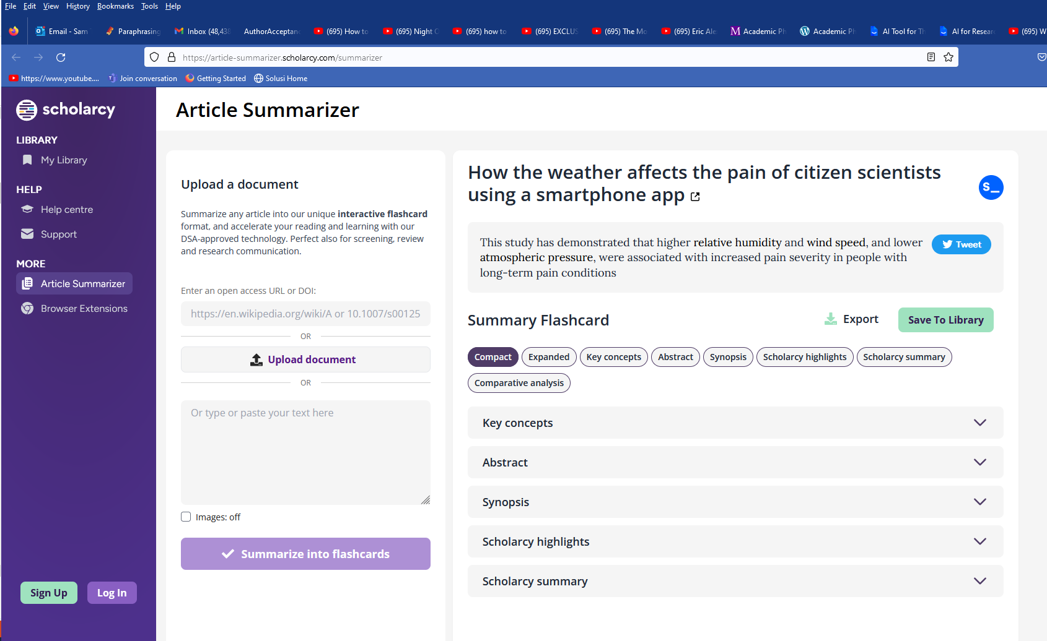

Slide 29
Important Considerations When Using AI in Academia
Data Quality Matters: The quality of AI outputs hinges on the quality of the data it's trained on. Researchers need to be critical of AI-generated results and ensure the underlying data is reliable, unbiased, and representative of the research question.
Ethical Considerations are Paramount: AI algorithms can perpetuate existing biases if not carefully designed and monitored. Researchers need to be mindful of ethical considerations when using AI in their work, ensuring fairness, transparency, and responsible data collection practices.
Human Expertise Remains Crucial: AI is a powerful tool, but it cannot replace human creativity, critical thinking, and interpretation skills. Researchers should leverage AI to augment their work, not replace it.
Policy always lags behind technology but it will always cope

Slide 30
Factors to consider about AI
Embrace AI as a tool:
Enhance lectures: Use AI for tasks like automated transcription or creating personalized study materials to free up time for more in-depth discussions.
Adapt to student needs: AI tutors can identify student weaknesses and personalize learning experiences.
Prepare students for the AI revolution:
Develop AI literacy: Teach students how AI works, its capabilities and limitations, and the ethical considerations surrounding it.
Focus on critical thinking: AI excels at tasks requiring data processing, but critical thinking and creativity remain human strengths

Slide 31

Issues to watch out for….
Are you tired of spending endless hours reading, writing and editing content?
Creativity erosion: But beware, too much AI-generated content can harm the quality of your work.
Unethical use of AI by your students: Are worried about unethical use of AI by your students?
Mitigating unethical practice: That’s where AI Content Detection Tools come.

Slide 32
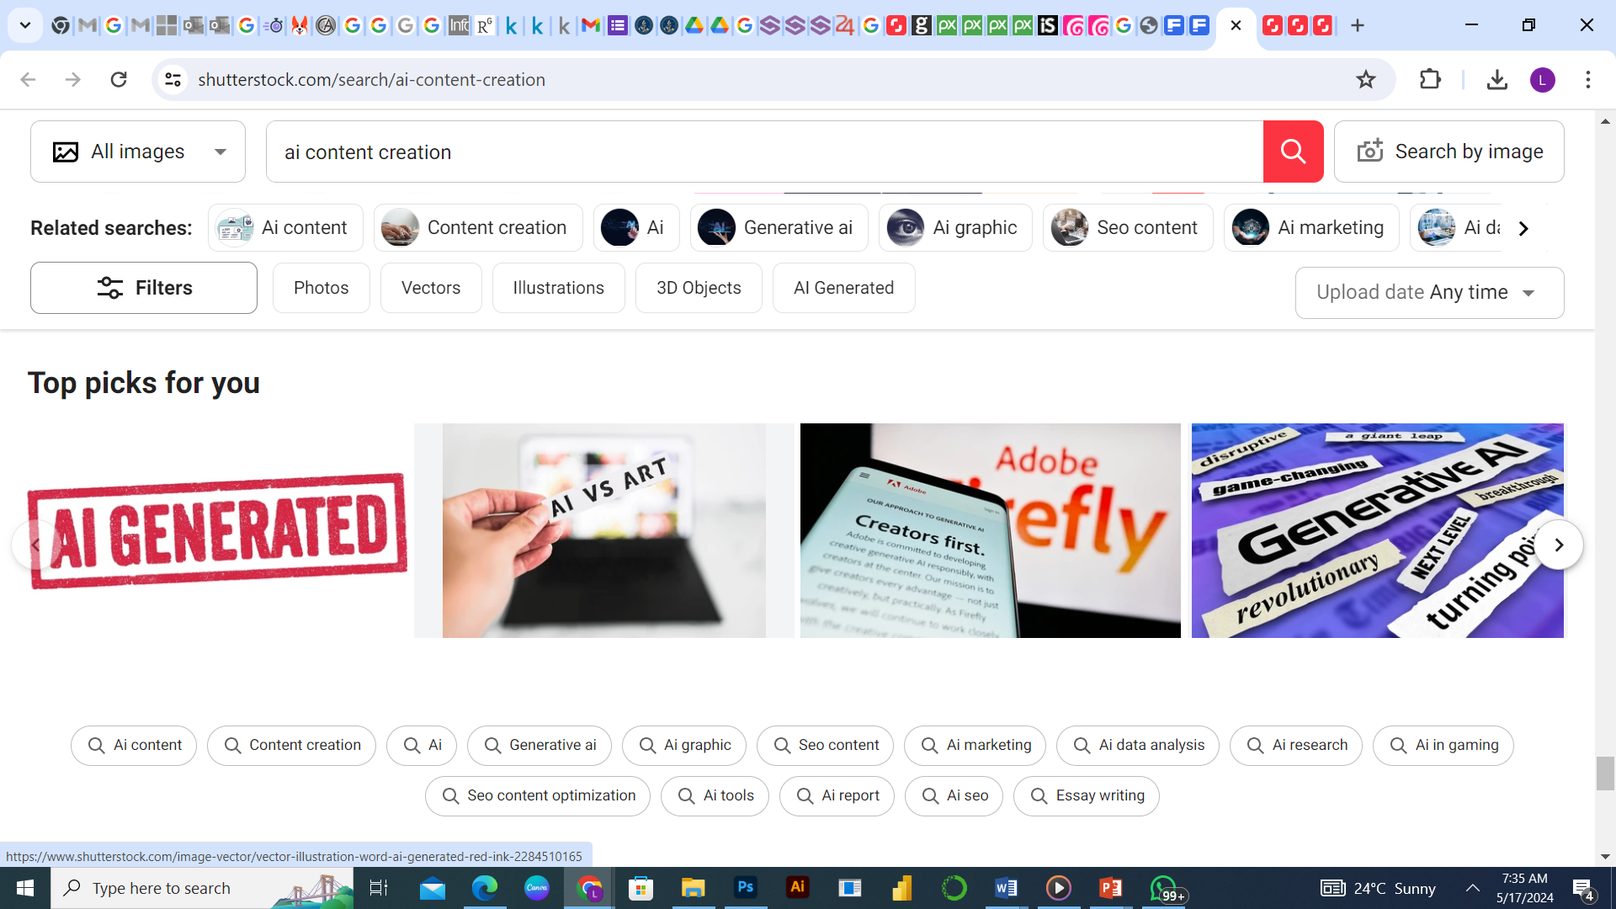
What is AI Content ?
AI Content is a type of artificial intelligence (AI) software-generated content.
AI systems can be trained to create content using natural language processing and machine learning algorithms.
This technology is becoming increasingly popular as it enables businesses, students as well as academics to produce high volumes of AI-generated Content in a fraction of the time it takes humans to write the same article from scratch e.g. an assignment, document or any form of written work.

Slide 33



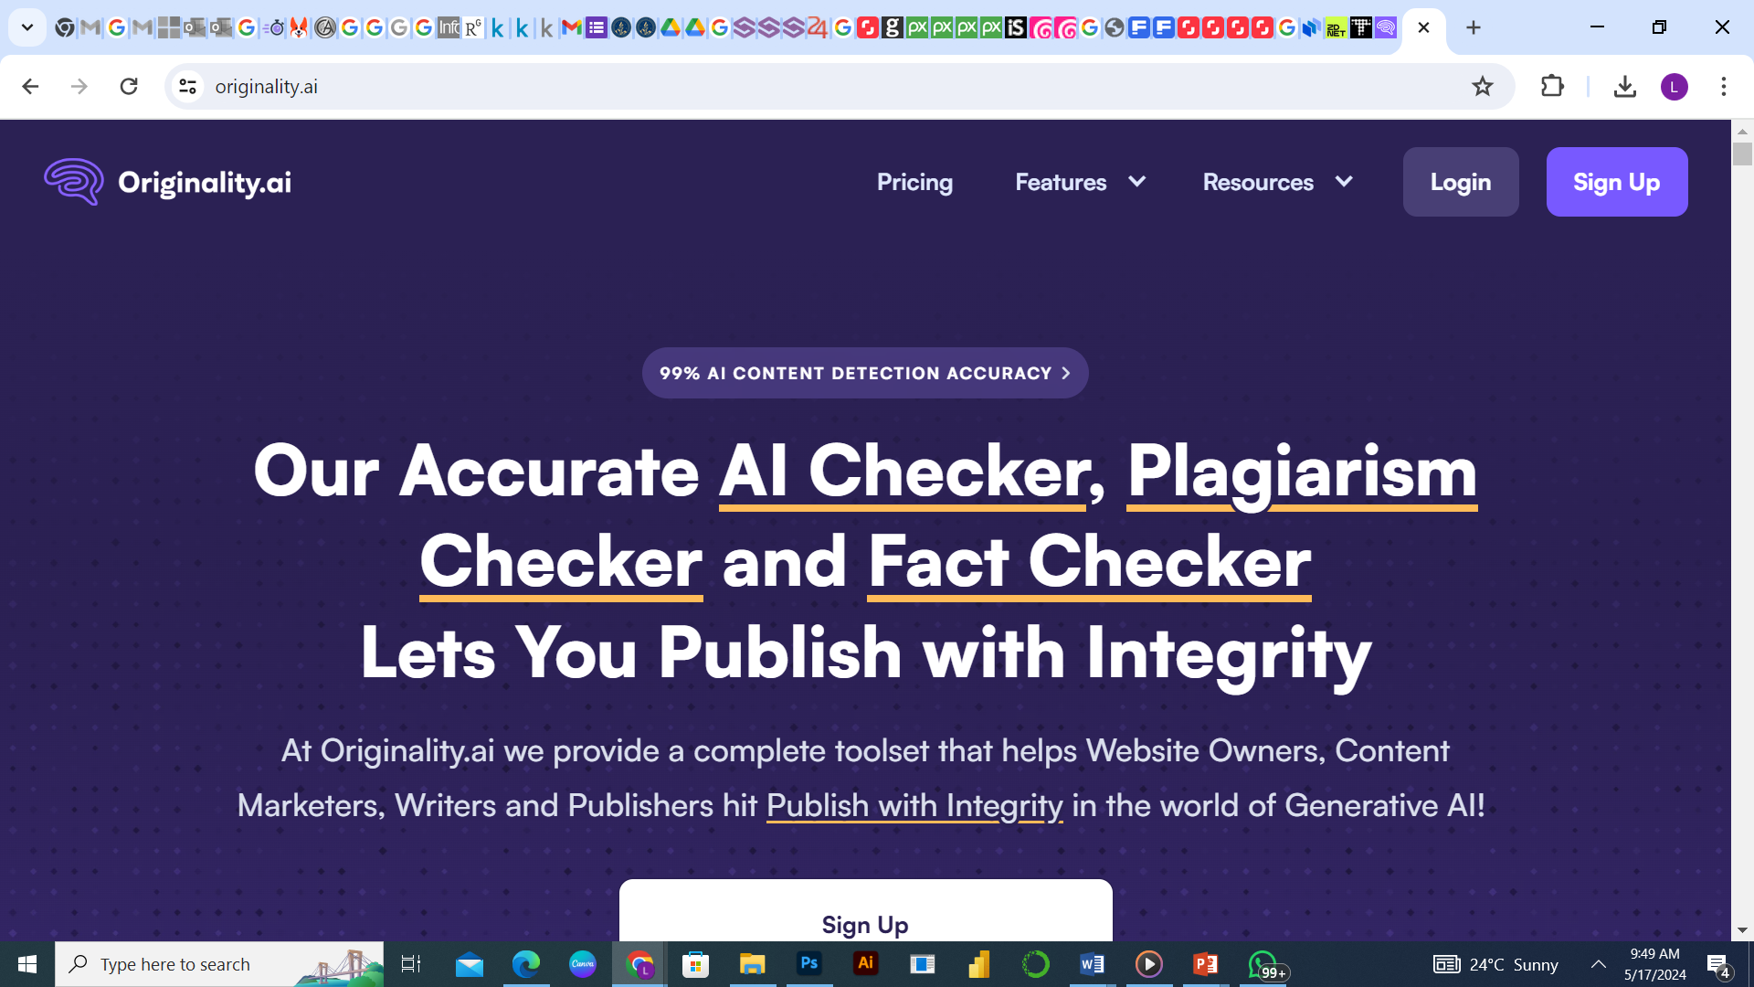
AI Content Creation Tools
Students can can now harness the power of AI to create articles in a fraction of the time.
ChatGPT, an OpenAI creation, is a dynamic language model known for its remarkable ability to produce life like text. With a knack for crafting natural
Writesonic stands out for its article writing proficiency. Its cutting-edge Article Writer 6.0 works with real-time Google research, so you can be more confident that the content output is accurate and up to date compared to content generation tools that work with older AI models.
Paragraph AI offers a simple tool that you can use as a browser extension, a mobile app, or an implementation to your keyboard. It works alongside you to boost your writing proficiency and edit your tone of voice while on the go.

Slide 34
Originality.AI
This tool has been rated as the ‘best’ AI detection tool so far.
As it offers numerous AI detection capabilities across its features e.g.
AI detection: Originality.ai can detect AI-generated texts produced by several AI text generation models Chat GPT, Gemini, Mistral with approximately 94% accuracy.
Plagiarism detection: You can simultaneously scan for plagiarism and AI with Originality.ai. The tool also highlights plagiarized content.
Chrome extension: You can also install the Chrome extension of Originality.ai and scan for AI-generated texts without visiting the platform’s dashboard.

Slide 35
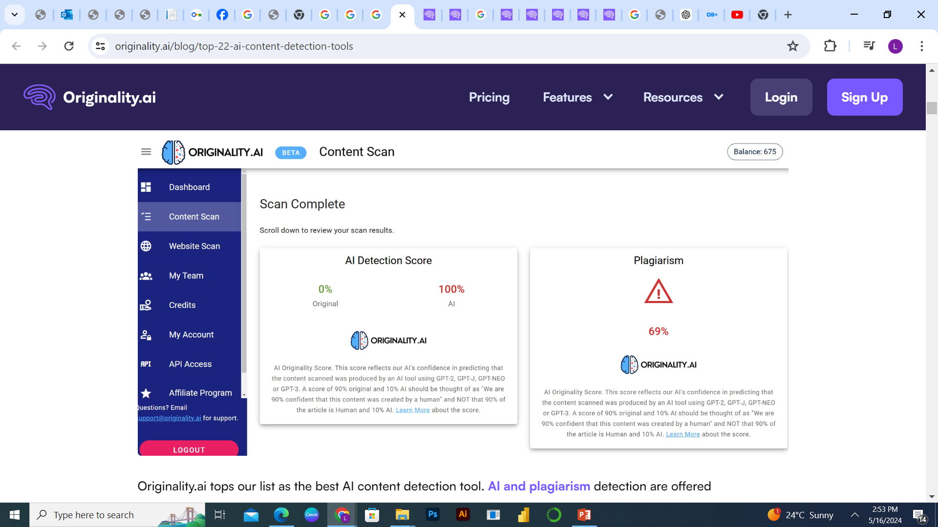
Originality AI Dashboard Interface

Slide 36

GPT Zero
GPTZero utilizes the latest advancements in language models to identify AI-written texts accurately.
With its innovative approach to analyzing texts based on perplexity.
GPTZero delivers a more sophisticated and precise approach to detecting AI-generated content.

Slide 37
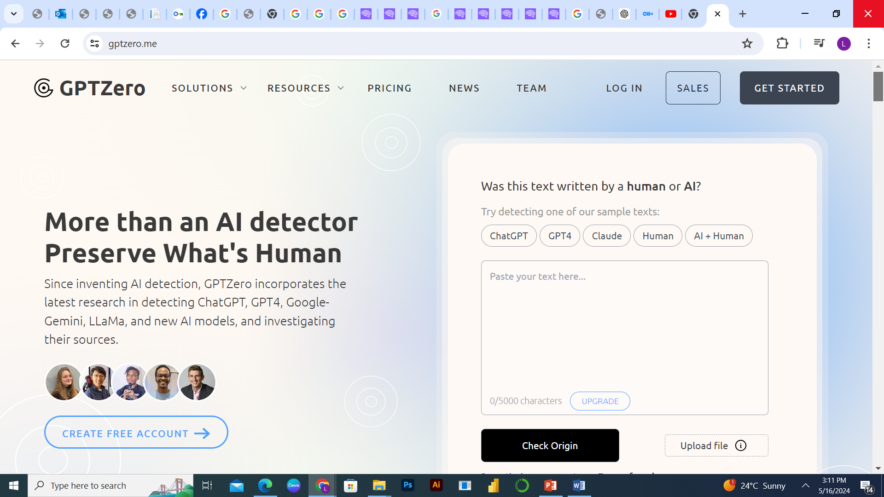
GPT Zero Interface

Slide 38
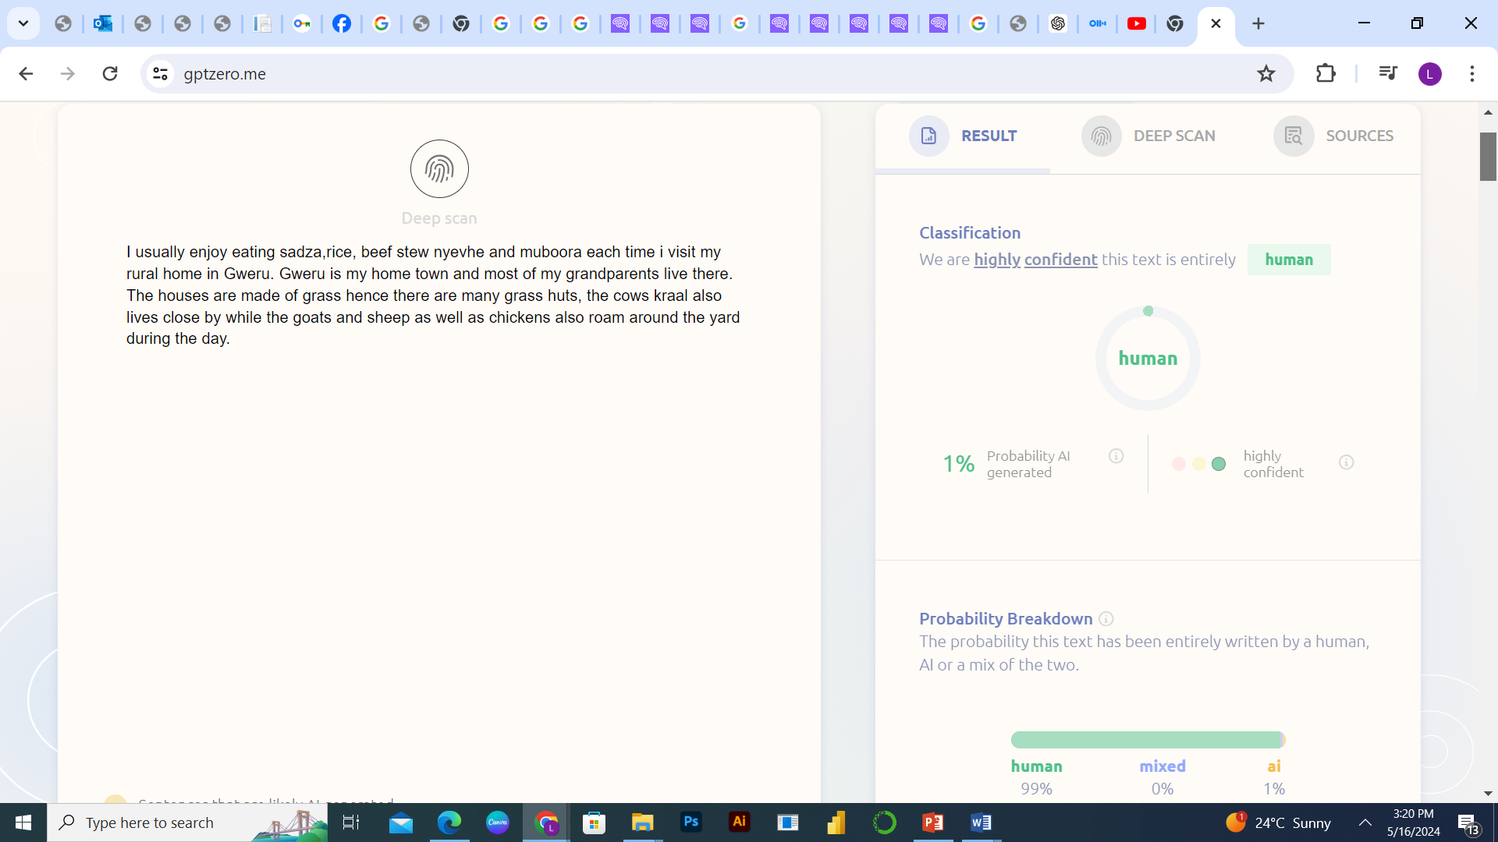
GPT ZERO Test Output

Slide 39
Towards AI regulation
Schools and countries must create policies on AI e.g.
European Union has a new regulation for artificial intelligence (AI) called the AI Act.
AI Risk Levels: The Act classifies AI systems based on risk. High-risk AI needs to meet stricter requirements than low-risk AI. AI Risk Levels: The Act classifies AI systems based on risk. High-risk AI needs to meet stricter requirements than low-risk AI.
Focus on Trustworthy AI: The goal is to make sure AI is developed and used in a way that respects human rights and doesn't cause harm.
Prohibited Uses: Certain AI practices are banned, like those that manipulate people or exploit vulnerabilities.
EU AI Office: A new office oversees enforcement and helps make Europe a leader in responsible AI.

Slide 40
Conclusion
By harnessing the capabilities of AI responsibly, academics can unlock new avenues for discovery, enhance research efficiency, personalize learning experiences, and ultimately, contribute to significant advancements across various fields of study.
The boldness of the onset often overcomes the fear of the result.“

